Slide 1
Cognitive Science for AI
Biology
Notes:
Hello, This is Cognitive Science for AI, the things they don’t talk about in a class in Artificial Intelligence but it’s what it is all in reference to. This sequence is about biology.

Slide 2
Biology - Neuroscience
Neurons
Brain Anatomy and Physiology
The Senses

Slide 3
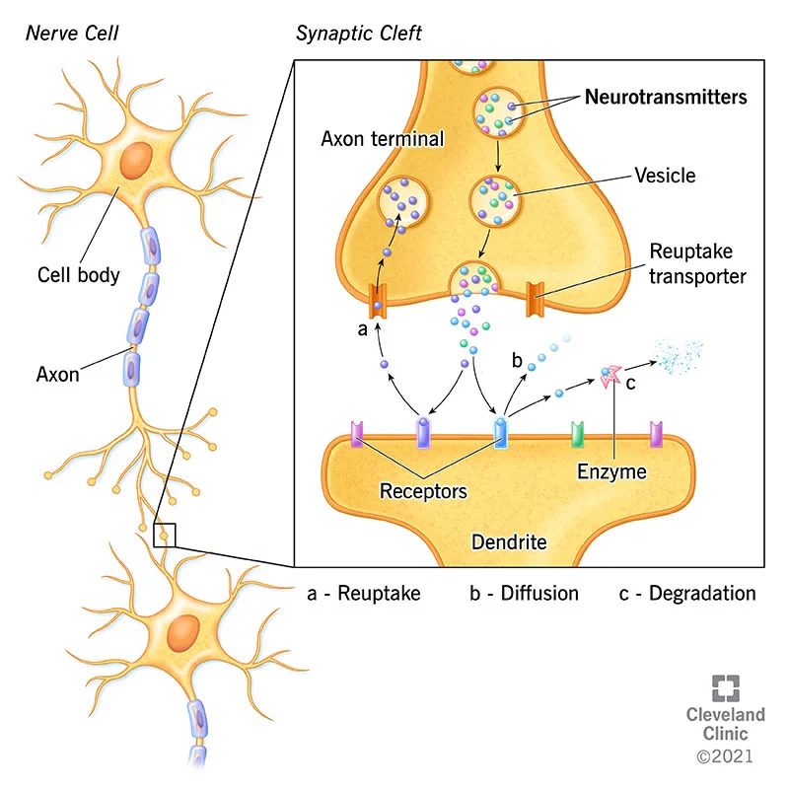
Neural Anatomy and Physiology

Slide 4
Neural Anatomy and Physiology
How Signals Travel
Enough signals reach a neuron’s cell body via dendrites
Along the axon leading out of the cell body, an electron potential (a difference in ion concentration) is created
Sodium ions are pumped out and potassium pumped in through ion channels in the cell wall
This ‘action potential’ travels from one end of the axon to the other in a wave
When the signal (the action potential) reaches the axon terminal, neurotransmitters are released into the synapse, the small gap between the terminal and the dendrites of another neuron
These neurotransmitters are then received by the other neuron

Slide 5
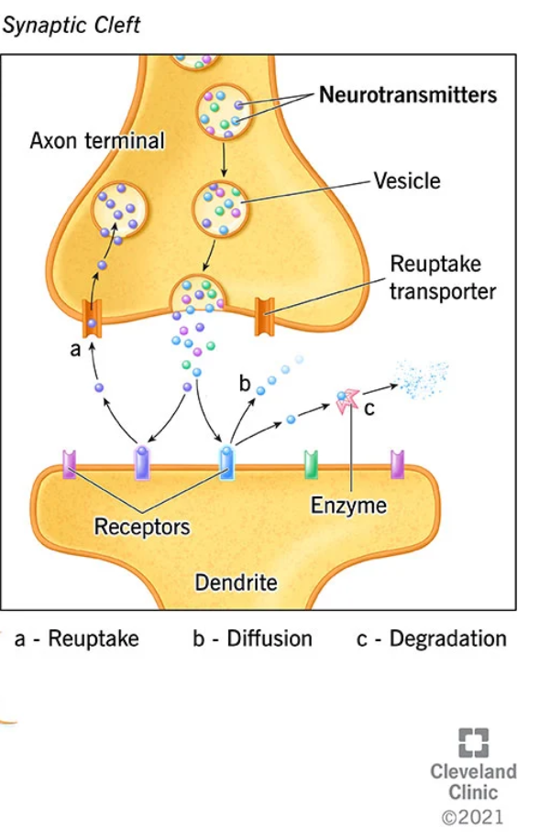
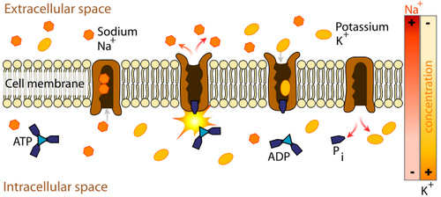
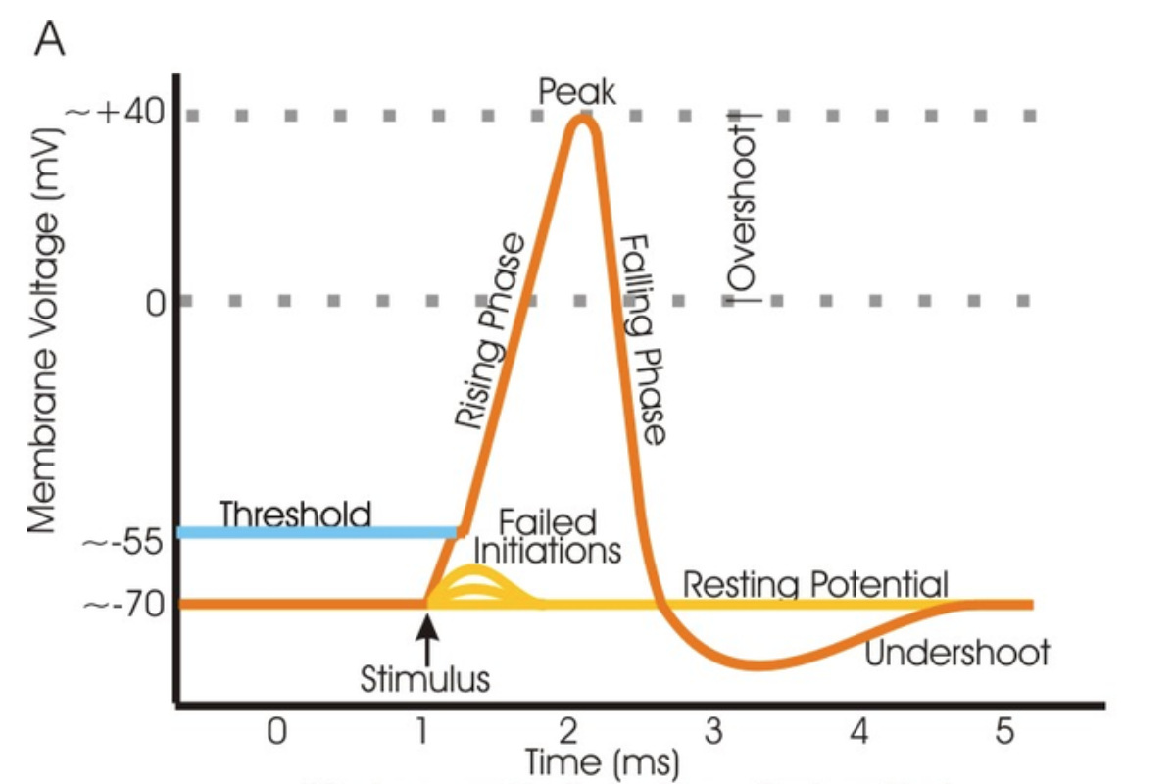
Neural Anatomy and Physiology
Action Potential
https://en.wikipedia.org/wiki/Neuron
https://med.libretexts.org/Courses/James_Madison_University/A_and_P_for_STEM_Educators/08%3A_Overview_of_the_Nervous_System/8.05%3A_Neurophysiology/8.5E%3A_The_Action_Potential_and_Propagation
https://flexbooks.ck12.org/cbook/cbse-biology-class-10/section/6.2/related/lesson/the-nerve-impulse-advanced-bio-adv/
https://my.clevelandclinic.org/health/articles/22513-neurotransmitters

Slide 6
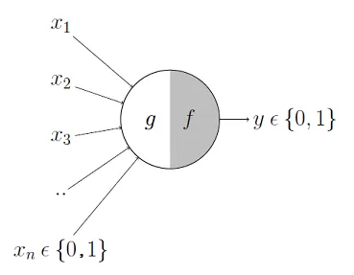
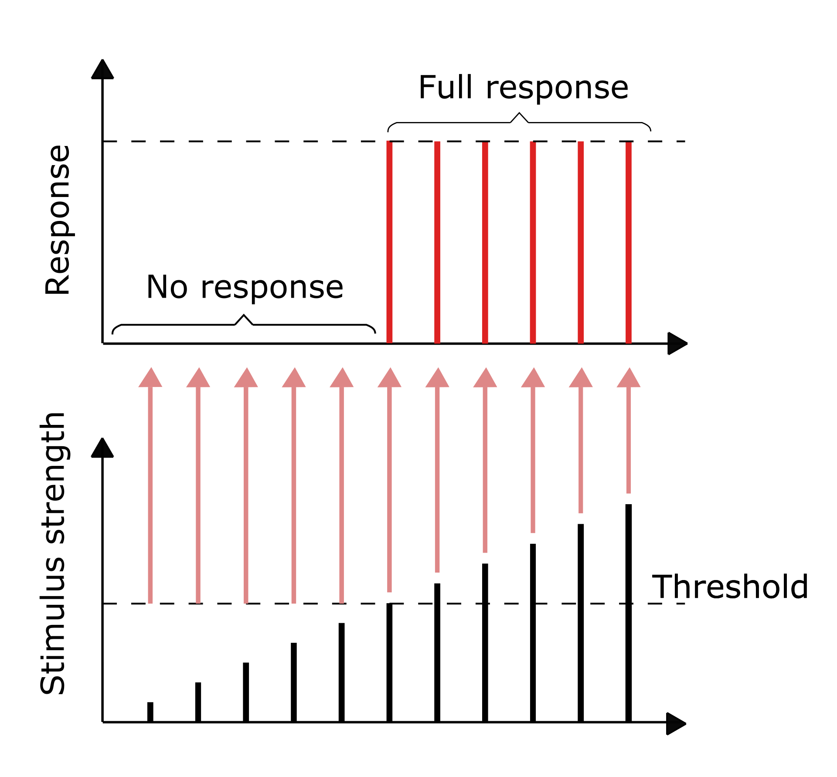
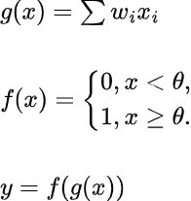
Elementary Neuron Model
McCulloch and Pitts 1943
Mathematical Model for a neuron

Slide 7
Cognitive Science for AI
The Brain

Slide 8
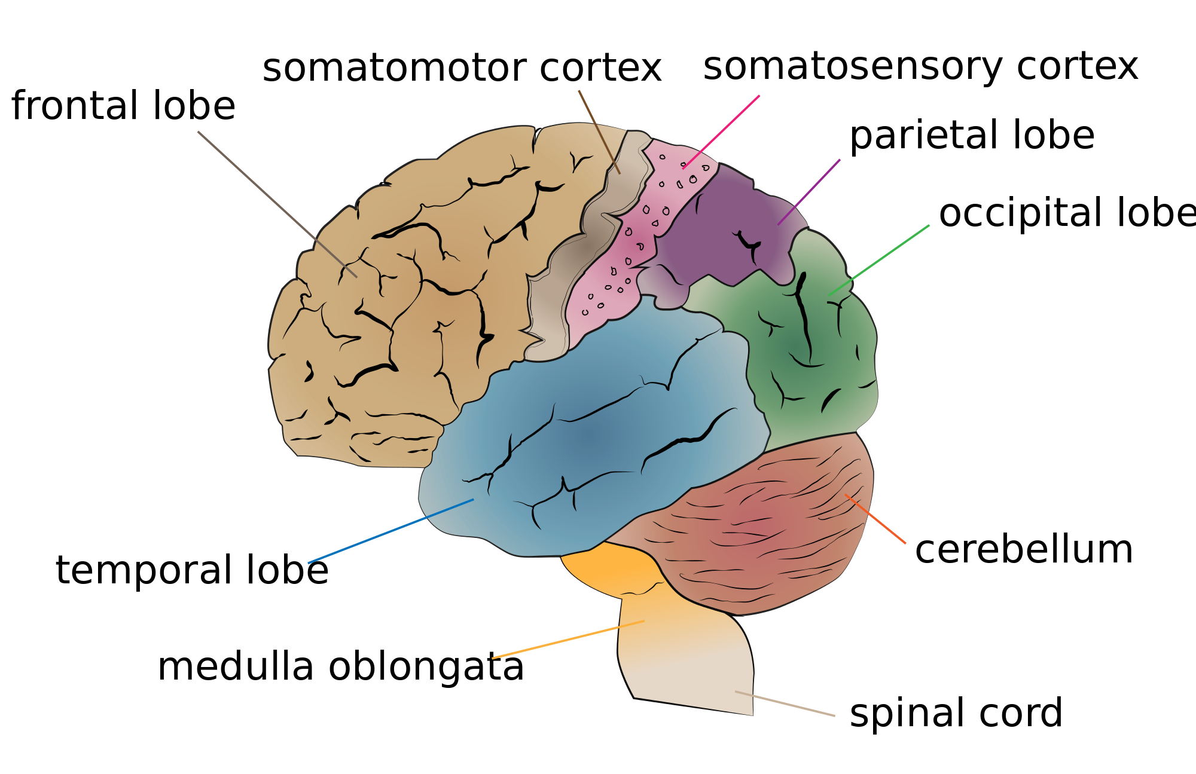
Gross Brain Anatomy
https://en.wikipedia.org/wiki/Perception#/media/File:Cerebrum_lobes.png

Slide 9
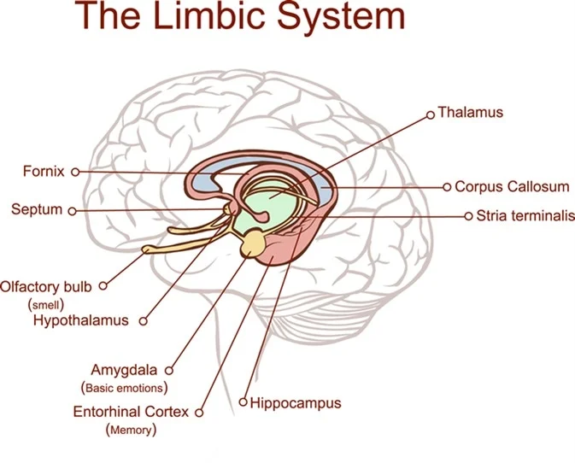
Limbic System
Hypothalamus
hunger, temp, fear
Hippocampus
consolidation of long term memories
spatial processing/memory
Amygdala
control of emotion, aggression
episodic-autobiographical memory
Thalamus - connections

Slide 10
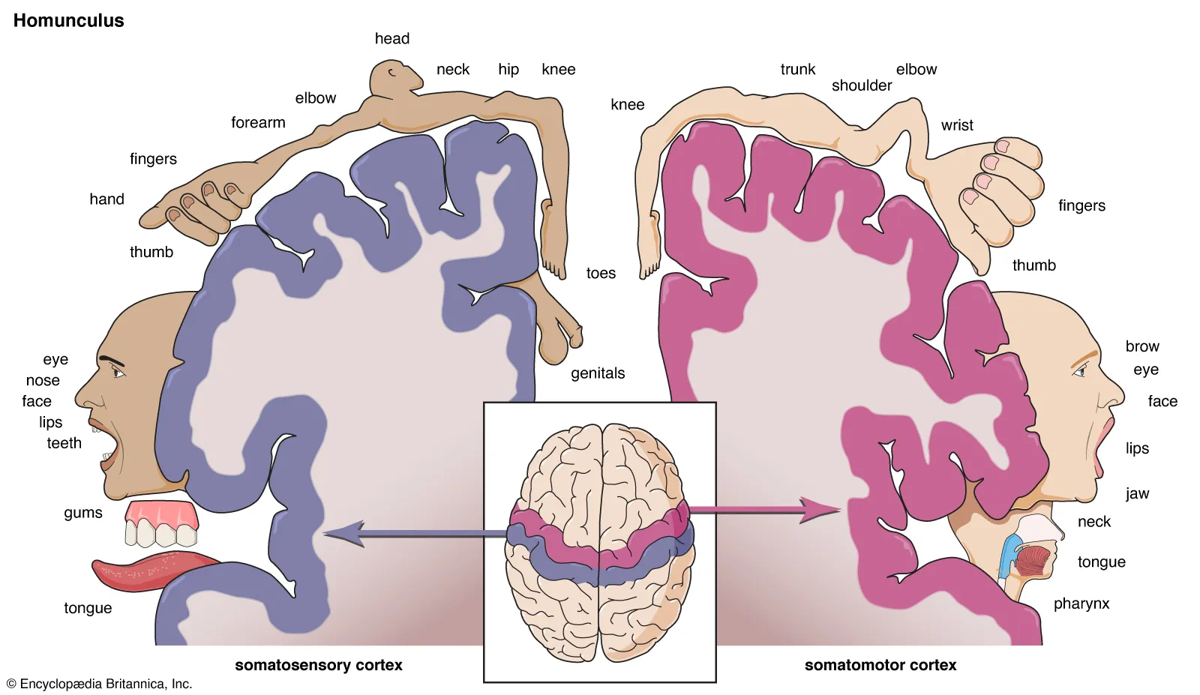
Sensory and Motor Homunculi

Slide 11
Brain Size
Brain size in neurons
C. elegans (Roundworm/Nematode) 302
Fruit Fly 2.5t
Bee 170t
Rat 31m
Dog 627m
Horse 1.2b
Raven 1.2b
Chimp 7.4b
Human 16.3 b
Orca 43b
https://en.wikipedia.org/wiki/List_of_animals_by_number_of_neurons

Slide 12
Cognitive Science for AI
The Senses

Slide 13
Senses
External stimuli
Vision
Light
Eye/Optic Nerve
Hearing
Sound
Inner Ear/Auditory Nerve
Touch
Pressure, Temperature, Pain
Skin Receptors, peripheral nerves
Smell/Taste
Chemical concentration
Chem Receptors, Olfactory Bulb
Internal Stimuli
Balance
Orientation/Movement
Semicircular canals/Auditory Nerve
Pain
Cell Destruction
Skin and Body
Proprioception
muscle tension/fatigue
Joints, muscles
Hunger, Emotions, etc
Glucose, CO2, Hormones

Slide 14
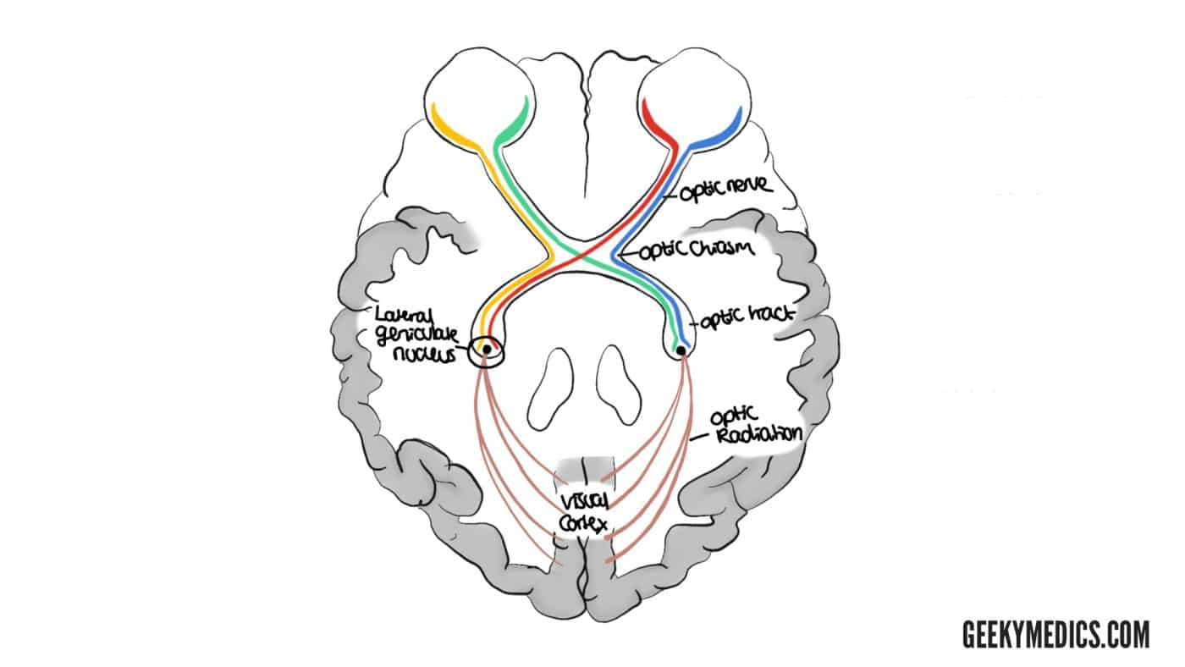
Visual Pathway
Rods (B/W) and cones (L/M/S)
Left/Right Retinas
Optic Nerves to Optic Chiasm
Lateral Geniculate Nucleus (in Thalamus) movement, depth, R/G B/Y opponent process
Visual Cortex - Occipital Lobe
V1 - primary retinotopic, edge detection, gaze shift
V2-V6
Visual Association Cortex and further
Dorsal -> Parietal Lobe, Location, short term, ‘how’
Ventral-> Temporal Lobe, Object Identification, long term, ‘what’
To other lobes
Fusiform Facial Area -(FFA) Facial Recognition
Parahippocampal Place Area (PPA) - Place
https://geekymedics.com/visual-pathway-and-visual-field-defects/

Slide 15
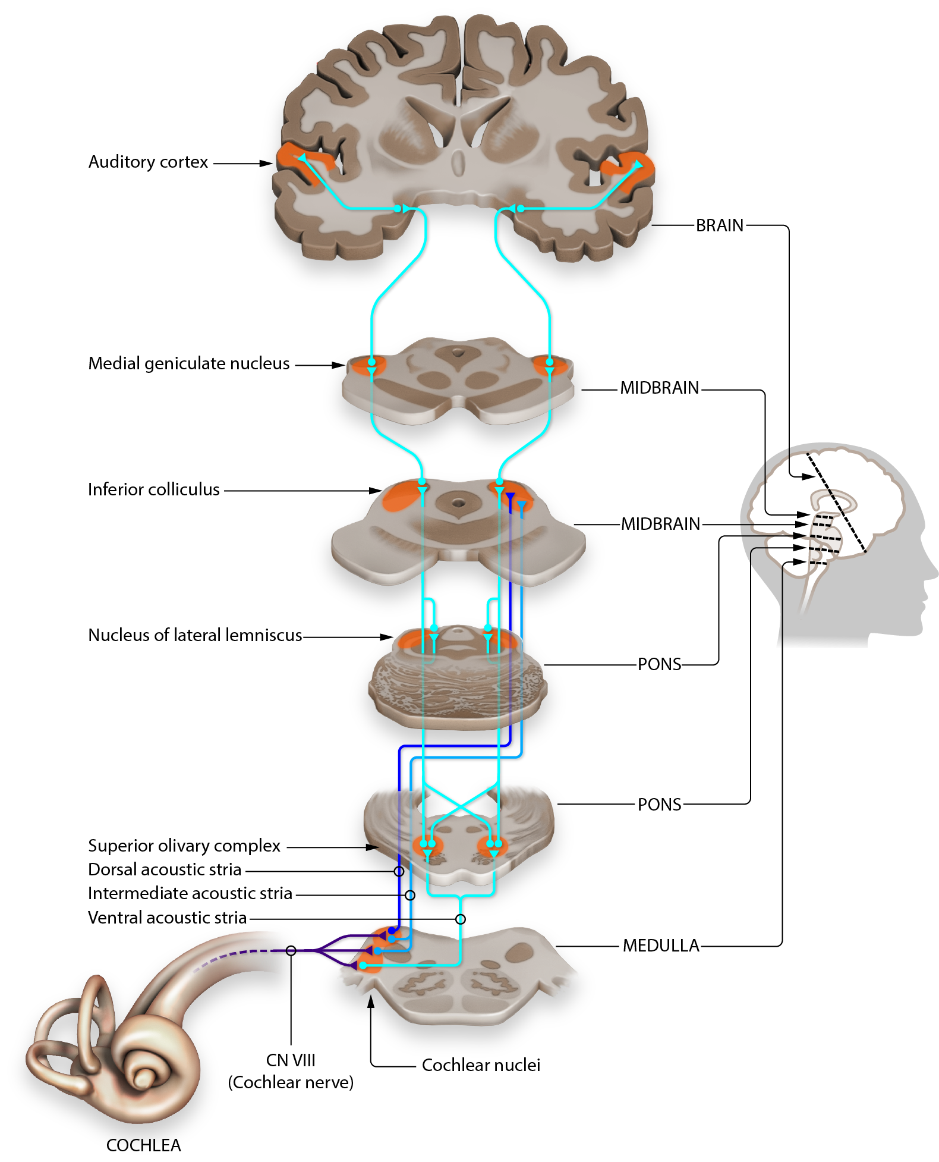
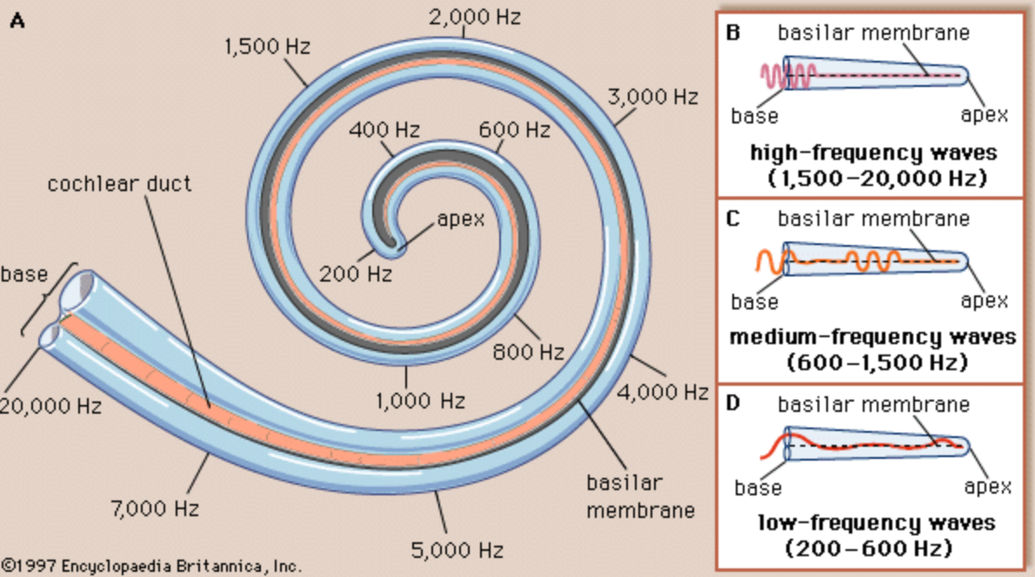
Auditory Pathway
Cochlea: Frequency ‘piano keyboard’
Cochlear Nerve
Medulla -> Pons -> Inferior Colliculus -> Medial Geniculate Nucleus
Auditory Cortex - temporal lobe
Tonotopic - mapping to keyboard
Broca’s Area - speech recognition
Wernicke’s Area - speech production
https://pressbooks.umn.edu/sensationandperception/chapter/auditory-pathways-to-the-brain-draft/
https://www.britannica.com/science/inner-ear#/media/1/288499/18100

Slide 16
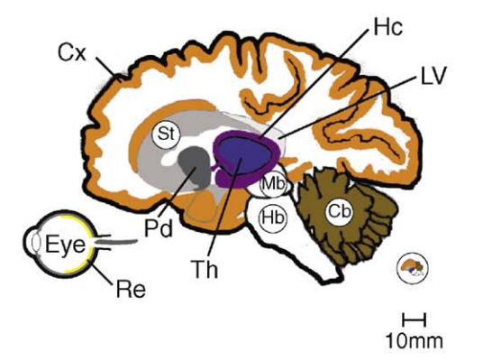
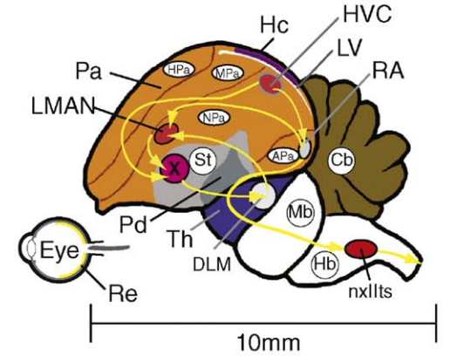
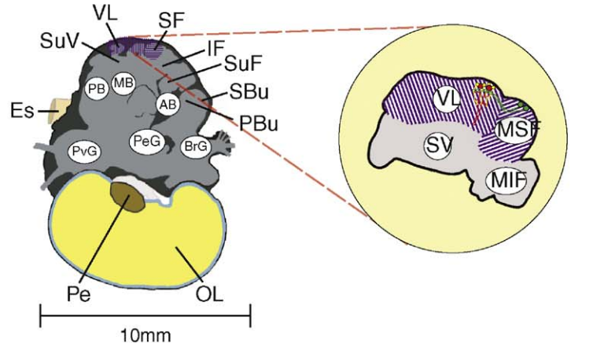
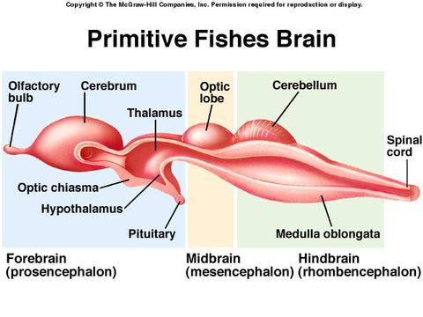
Comparative Brain Anatomy
https://anglerfishmcf.weebly.com/nervous-system.html
https://pdf.sciencedirectassets.com/271059/1-s2.0-S0166223609X00093/1-s2.0-S0166223609001295/main.pdf

Slide 17
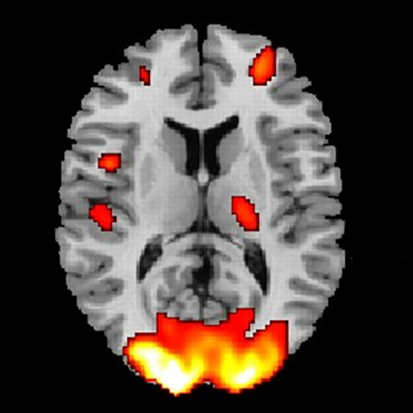
Unexpected Subtleties
Asymmetry: left and right not the same
Inhibitory action
Interconnections - large and small scale
Reductionism vs Holism
Every location one function - modular machine parts
But function covered by multiple/unspecified areas
Effects of injury can be reduced/overcome
Comparative anatomy
Mammals - all levels of anatomy same or very close
Birds - neurons same, gross anatomy homologous
Cephalopods - neurons similar, gross anatomy differs
How do we know all this?
Behavior of people after accidents/strokes/surgery and comparing with autopsy
Behavior during brain surgery
New cryo+imaging techniques, fMRI, MEG/SQUIDs
Mostly primate/rodent experimentation
https://www.brainline.org/slideshow/brain-imaging-what-are-different-types

Slide 18
Lessons from Biology/Neuroscience
The brain is not a computer
There is no CPU, no monolithic memory bank
No software, no separable ‘program’ - it’s all (biochem) hardware
The network of neurons is not an Artificial Neural Network
The eye is not a snapshot or movie camera (similar for ear)
The senses are fallible - the brain fills in gaps, makes assumptions
There’s a lot we just don’t know (we don’t know enough to simulate)

